Slide 1


FASHION_WAVE SALES PERFORMANCE DASHBOARD
FASHION_WAVE SALES DASHBOARD
WEEKEND VS WEEKDAY INSIGHTS & +15% GROWTH STRATEGY
“SALES PERFORMANCE ANALYSIS”
PRESENTED BY:- ANSHIKA GOYAL
DATE:- 30-NOVEMBER-2025

Slide 2
PROJECT OVERVIEW AND BUSINESS PROBLEM
BUSINESS CONTEXT
Fashion_Wave is a retail clothing brand experiencing fluctuating sales performance across weekdays and weekends. Management wants to improve overall revenue and profit margins by understanding customer buying patterns.
Weekend sales are lower compared to weekday sales, which affects revenue potential. The business has set a target to increase weekend sales by 15%, but the factors impacting performance are unclear.
Compare weekend vs weekday sales performance
Identify high–performing product categories and underperforming stores
Analyze impact of discounts on profit
Generate data-driven insights & growth recommendations
Use sales data to build a dashboard and recommend strategies to increase weekend revenue by at least 15%.
PROBLEM STATEMENT
OBJECTIVE
GOAL

Slide 3
Exploratory Data Analysis (EDA) was performed to understand dataset structure, detect patterns, and prepare the data for insights and dashboard building. The dataset contains detailed transactional information including Product Category, Date, Quantity, Sales Amount, Discounts, Profit, Customer Type, and Payment Mode.
Reviewed dataset shape and column structure (InvoiceNo, Date, Category, Quantity, UnitPrice, Discount, Total Sales, Profit, etc.)
Converted date column into proper date format and extracted Month & Weekday
Created Weekend Flag to compare Weekend vs Weekday performance
Calculated additional metrics including:
    Total Sales
    Average Order Value
    Profit Margin
    Discount Impact
Cleaned missing or incorrect values
Built pivot tables to analyze:
EXLPORATORY DATA ANALYSIS (EDA)
KEY EDA STEPS PERFORMED

Slide 4
    Sales by Category
    Sales by Customer Type (New vs Returning)
    Payment Mode contribution
    Profit distribution
    Weekend vs Weekday performance
To deeply understand sales behavior and identify meaningful patterns that support decision-making and answer business questions regarding:
Revenue and profit drivers
Seasonal and weekly trends
Customer buying behavior
Impact of discounting on profitability.

Slide 5
INSIGHTS AND KEY FINDINGS
🔍 Insights & Key Findings
1. Weekend Sales Performance:
Weekend sales contribute significantly to overall revenue, but they are still lower compared to weekday sales. Increasing weekend-focused promotions can boost revenue growth.
2. Sales Trend Analysis:
The daily sales trend shows noticeable fluctuations, indicating potential demand variation based on day and customer traffic patterns. Peak days can be leveraged for targeted marketing.
3. High Sales Days:
Saturday and Sunday show higher customer engagement compared to mid-week. Focusing on weekend combos or discounts may help increase the conversion rate further.
4. Improvement Opportunity:
There is a strategic opportunity to increase weekend sales by at least 15%, which can generate considerable revenue growth if implemented through offers, bundling, or social media campaigns.

Slide 6
KPI Metrics & Performance Summary
• Total Revenue: ₹ 30,012.57
• Total Orders / Transactions: 15,000
• Average Order Value (AOV): ₹ 14,155.93
• Total Quantity Sold: 51,975
• Weekend Sales % of Total: 28.26%
• Highest Selling Category: Accessories
• Lowest Selling Category: clothing
• Highest Sales Day: 4/12/2023
• Lowest Sales Day: 12/17/2023
✨ Interpretation:
These KPIs provide a clear summary of overall business performance, helping identify high-performing categories, sales patterns by days, and areas that require improvement.

Slide 7
VISUALIZATION & DASHBOARD
To support the KPI findings, multiple visual analytics charts were created in Google Sheets to better understand sales performance patterns and key business insights. These charts helped transform numerical data into easily interpretable insights for decision-making.
A column chart was created to compare sales across weekend and weekday dates.
Insight:
Weekday sales consistently outperform weekend sales. However, significant spikes occur on certain weekend dates, indicating promotional or seasonal impact. Saturday contributes the highest weekend revenue.
A line trend chart was developed to track sales patterns over time.
Insight:
Sales show a repeating cyclic pattern where weekday sales peak followed by weekend drops. This trend suggests stronger regular sales during working days and potential opportunity for boosting marketing campaigns on weekends.
DAILY SALES COMPARISON- WEEKEND VS WEEKDAY
WEEKEND VS WEEKDAY SALES TREND

Slide 8
A bar chart visualizes sales distribution across product categories.
Insight:
Accessories generate the highest sales contribution, followed by Clothing and Shoes. This helps identify profitable product focus areas.
A pie chart was created to show category-wise percentage contribution to total revenue.
Insight:
Accessories contribute approximately 42.8% of total revenue, indicating strong product performance and high customer demand.
A comparison bar chart was generated to analyze overall revenue contribution.
Insight:
Weekdays account for the highest overall revenue while weekends contribute approximately 28.26% of total sales, which is below the expected target of 32.5%. This indicates an opportunity to implement weekend discount strategies.
SALES BY PRODUCT CATEGORY
PRODUCT CATEGORY REVENUE CONTRIBUTION
TOTAL WEEKEND VS WEEKDAY SALES

Slide 9
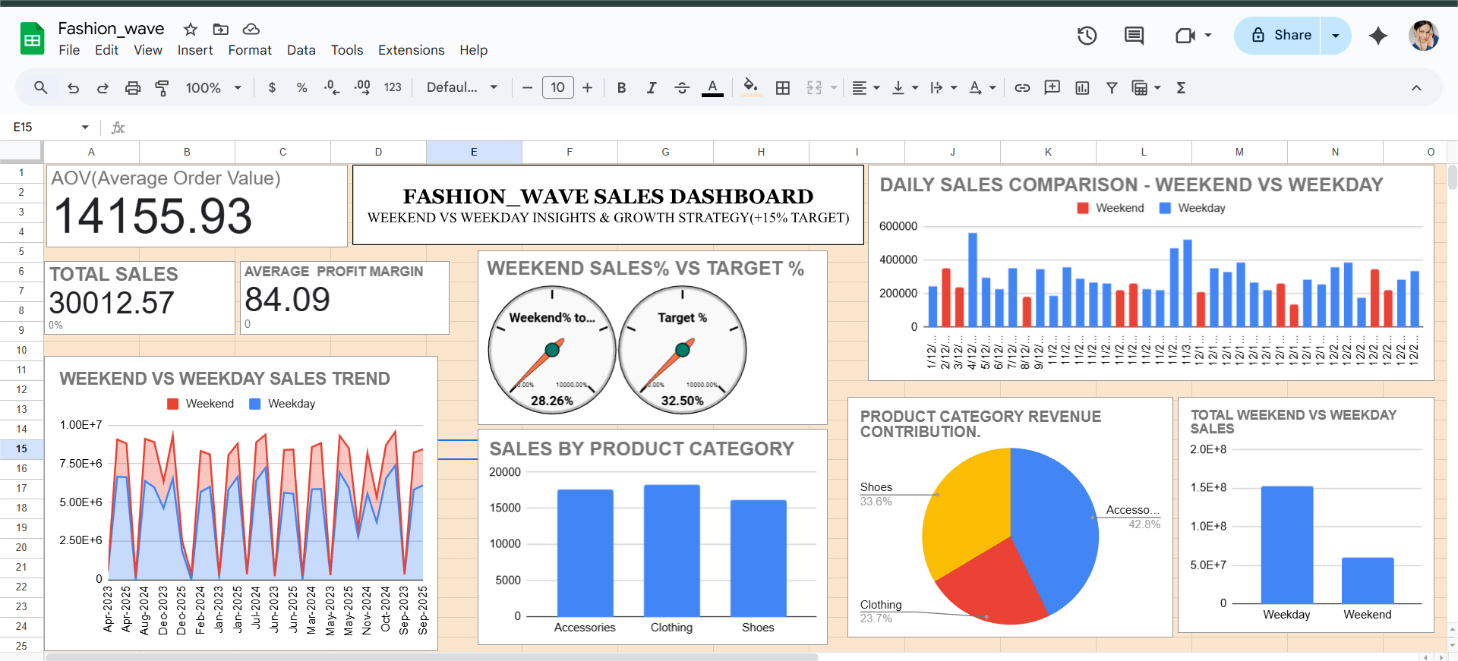

Slide 10
RECOMMENDATIONS
Based on the sales performance insights and weekend/weekday comparison, the following actions are recommended:
📌 Quick Win Strategies
Increase weekend discounts and promotional offers to improve weekend sales contribution (currently 28.26% vs target 32.5%).
Focus on Accessories, which are the highest-selling category, and introduce bundle offers.
Optimize stock and staffing on peak days identified from daily sales charts.
📌 Long-Term Strategies
Improve performance of low-selling categories such as Clothing and Shoes through targeted marketing.
Implement customer segmentation to personalize offers for high-value repeat customers.
Analyze seasonal patterns to plan inventory and marketing budgets more efficiently.

Slide 11
CONCLUSIONS & NEXT STEPS
The Fashion_Wave sales analysis provided clear insights into overall business performance, customer buying behavior, and revenue patterns across weekdays, weekends, and product categories. The dashboards and KPI metrics highlight that weekday sales are significantly stronger than weekend sales, with weekends contributing only 28.26% of revenue compared to the target of 32.5%. This indicates a strong opportunity to improve weekend performance through targeted marketing and discount campaigns.
The results also show that Accessories are the highest-selling product category, while Clothing and Shoes underperform, providing direction for inventory planning, pricing adjustments, and promotional focus. The visual trend charts further reveal consistent demand variation across different dates, helping guide operational and forecasting decisions.
Overall, the project demonstrates how data-driven analysis can convert raw data into actionable business recommendations and enable better decision-making supported by a clear, interactive dashboard.
Next Steps:
Launch weekend offers and promotions to increase weekend sales share.
Focus on high-performing products (Accessories) and improve weaker categories.
Apply customer segmentation to personalize marketing campaigns.
Continue updating the dashboard for regular performance tracking.
Final Outcome
The analysis successfully identifies opportunities to improve sales growth and enable strategic planning, setting a strong foundation for future business optimization.

